Slide 1
Java Programming
Loops
循环
Notes:
本次课件不提前发布，需要课堂练习，和学生一起实践

Slide 2

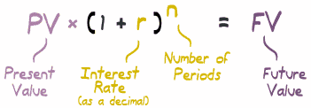
The Future value(终值)
Calculate the Future value(FV) according to given present value (PV), interest ratio and number of periods.

Slide 3
Outline
Loop statements
While statement
Do-while statement
For statement
Examples
The Future value
Mortgage payment
Fibonacci sequence
factorial
Continue, break & return
Print odd numbers
Check prime number
terminate your program manually
Nesting Loops
Chinese multiplication table
star triangles

Slide 4
While-loop statement
INITIALIZATION;
while (LOOP-CONDITION) {
STATEMENTS;
UPDATE;
}

Slide 5
Do-while loop statement
INITIALIZATION;
do {
STATEMENTS;
UPDATE;
} while(LOOP-CONDITION);
The difference between do-while and while is that do-while evaluates its expression at the bottom of the loop instead of the top. Therefore, the statements within the do block are always executed at least once.

Slide 6
Explanations
LOOP-CONDITION: The loop condition is used to control the execution of the loop body. It is an boolean expression which includes one or more loop variables. If the expression is true, the loop repeat.
INITIALIZATION: Before the loop statement executes, we should initialize the loop variables.
STATEMENTS: the statements will be executed repeatedly.

Slide 7
Explanations
UPDATE: The body of the loop should change the value of loop variables so that, eventually, the condition becomes false and the loop terminates. Otherwise the loop will repeat forever, which is called an infinite loop.
We must avoid infinite loop!
This type of loop is so common that there is another statement, the for loop, that expresses it more concisely.

Slide 8
For-loop statement
for (INITIALIZATION; LOOP-CONDITION; UPDATE){
STATEMENTS;
}
The while loop and for loop can be replaced with each other!
There is one difference between for loops and while loops: if you declare a variable in the initializer, it only exists inside the for loop.

Slide 9
The Future value
Find the Future value(FV) according to given present value (PV), interest ratio and number of periods.

Slide 10
MoneyUtils.java
public class MoneyUtils {
public static void main(String[] args) {
double fv, pv=1000.0, r=0.1;
int N=3;
fv=pv;
for(int i=0;i<N;i++) fv=fv*(1+r);
System.out.println(fv);
}
}

Slide 11
MoneyUtils.java (while version)
public class MoneyUtils {
public static void main(String[] args) {
double fv, pv=1000.0, r=0.1;
int N=3,i=0;
fv=pv;
while(i<N){
fv=fv*(1+r);
i++;
}
System.out.println(fv);
}
}

Slide 12
MoneyUtils.java (do-while version)
public class MoneyUtils {
public static void main(String[] args) {
double fv, pv=1000.0, r=0.1;
int N=3,i=0;
fv=pv;
do{
fv=fv*(1+r);
i++;
}while(i<N);
System.out.println(fv);
}
}

Slide 13
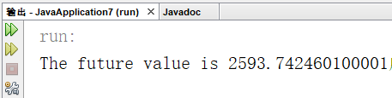
MoneyUtils.java (method version)
public class MoneyUtils {
public static void main(String[] args) {
double fv = calcFV(1000.0,0.1,10);
System.out.print(“The future value is ”+fv);
}
public static double calcFV(double pv, double r, int N) {
double fv=pv;
for(int i=0;i<N;i++) fv=fv*(1+r);
return fv;
}
}

Slide 14
Round to nearest hundredth
Two system classes can be used to round the result to nearest hundredth
BigDecimal
DecimalFormat
BigDecimal
The BigDecimal class provides operations for arithmetic, scale manipulation, rounding, comparison, hashing, and format conversion.
Notes:
http://docs.oracle.com/javase/7/docs/api/java/math/BigDecimal.html

Slide 15
Round to nearest hundredth
public static double round(double mt, int scale) {
BigDecimal bmt = new BigDecimal(mt);
double nmt =
bmt.setScale(scale,BigDecimal.ROUND_HALF_UP).doubleValue();
return nmt;
}
Converts this BigDecimal to a double
Returns a BigDecimal whose scale is the specified value

Slide 16
Round to nearest hundredth
DecimalFormat
The DecimalFormat class formats decimal numbers. It supports different kinds of numbers, including integers (123), fixed-point numbers (123.4), scientific notation (1.23E4), percentages (12%), and currency amounts ($123).
DecimalFormat df = new DecimalFormat("0.00");
df.setRoundingMode(RoundingMode.HALF_UP);
System.out.println(df.format(fv));
Format pattern
Returns a String value

Slide 17
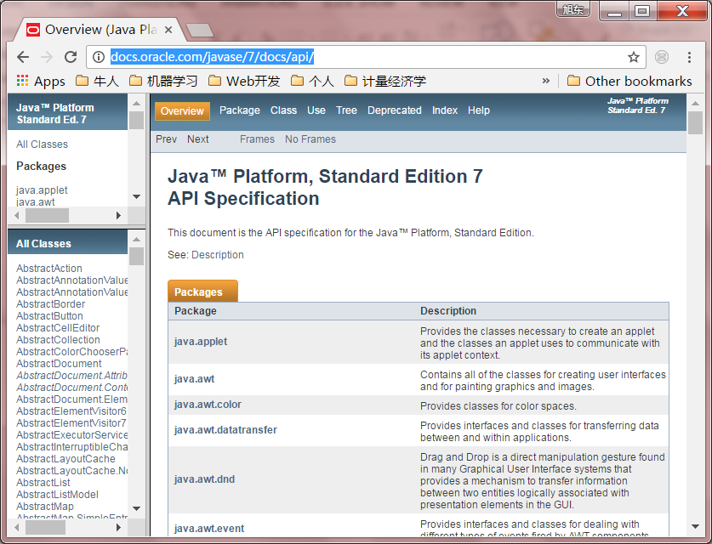
Java API specification
http://docs.oracle.com/javase/7/docs/api/

Slide 18
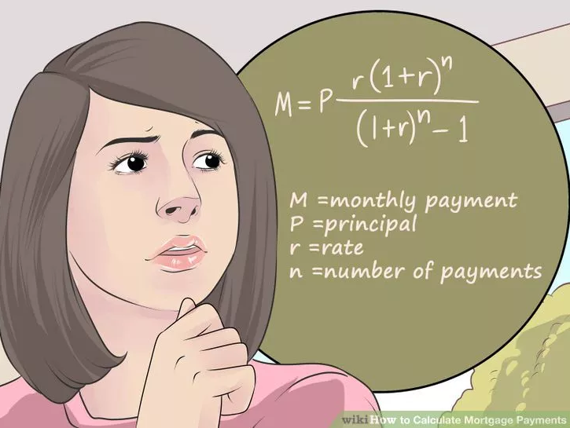
Mortgage payment(还房贷)

Slide 19
Mortgage payment
public static double mortgage(double pv, double r, int N) {
double mt=1.0;
for(int i=0;i<N;i++) mt=mt*(1+r);
mt=pv*r*mt/(mt-1);
return round(mt,2);
}

Slide 20
Fibonacci sequence (for version)
public static int Fibonacci(int n) {
if(n==0||n==1)return n;
int pre=0,next=1,temp;
for(int i=2;i<=n;i++){
temp=next;
next=next+pre;
pre=temp;
}
return next;
}
Notes:
斐波那契数列0 1 1 2 3 5 8 13 …
Debug该程序
public static int fib(int n) {
if (n == 0 || n==1) {
return n;
} else {
return fib(n-1)+fib(n-2);
}
}

Slide 21
Factorial (while version)
public static long factorial (long n){
if((n<0 || n>20)) return -1;
long factorial = 1;
while (n > 1) {
factorial *=n--; /* Multiply, then decrement. */
}
return factorial;
}
Notes:
Debug该程序
public static long fact (long n) {
if (n>20) return -1;
if (n==1) {
return n;
} else {
return n*fact(n-1);
}
}

Slide 22
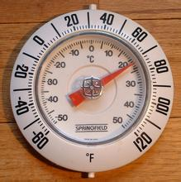
Quiz: Celsius and Fahrenheit
List the Frequently used Temperature both in Celsius (from -50 to 50) and Fahrenheit scales.
Fahrenheit are rounded to the nearest tenth (e.g. 838.274 rounded to the nearest tenth is 838.3)
F=(9/5)*C+32
Notes:
Celsius[ˈsɛlsiəs]
Fahrenheit[ˈfærənˌhaɪt]

Slide 23
Continue, break, & return
continue skips the current iteration of a loop and proceeds directly to the next iteration
break terminates a loop
return exits the method

Slide 24
Print the odd numbers
public static void printOddNumbers(int N){
for (int i = 1; i <= N; i++) {
if (i % 2 == 0)
continue; // skip next statement if i is even
System.out.print(i + " ");
}
System.out.println();
}

Slide 25
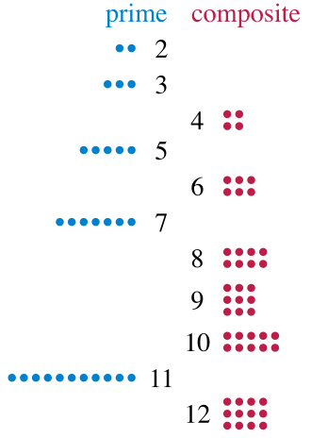
check prime number(素数)
public static boolean isPrime(int N) {
if (N<=1) return false;
for(int i=2;i<=N-1; i++)
if( N%i==0 ) return false;
return true;
}
Notes:
A prime number (or a prime) is a natural number greater than 1 that cannot be formed by multiplying two smaller natural numbers.
A natural number greater than 1 that is not prime is called a composite number.

Slide 26

check prime number
public static Boolean isPrime(int N) {
if (N<=1) return false;
for(int i=2;i<=Math.sqrt(N); i++)
if( N%i==0 ) break;
if( i>Math.sqrt(N) ) return true;
else return false;
}

Slide 27
Variable scope(变量作用范围)
Variable scope refers to the accessibility of a variable. The scope of the variable is the block in which it is defined.
You cannot refer to a variable before its declaration.

Slide 28
Variable scope
You can declare variables in several different places:
In a method's body as local variables
As parameters of a method or constructor.
In a method's body or a constructor's body.
Within a statement block, such as inside a while or for block.
In a class body as class fields. Variables declared here are referred to as class-level variables (we will talk about it in the future).
If a method declares a local variable that has the same name as a class-level variable, the former will 'shadow' the latter.

Slide 29

check prime number
public static Boolean isPrime(int N) {
if (N<=1) return false;
int i;
for(i=2;i<=Math.sqrt(N); i++)
if( N%i==0 ) break;
if( i>Math.sqrt(N) )return true;
else return false;
}

Slide 30
Terminate program manually
Run your program…
The main method is invoked…
Input something ….
Calculating and outputting …
…
Your program are exited by JVM…
Can you terminate your program by yourself?

Slide 31
Terminate program manually
public static void menu() {
int choice=0;
Scanner sc = new Scanner(System.in);
while(true){
System.out.println("functions:");
System.out.println("1: calculate future values");
System.out.println("2: calculate mortgage payment");
System.out.println("0: exit");
System.out.println("please input your choice:");
choice = sc.nextInt();
switch (choice){
case 0:
return;
case 1:
System.out.println(“The future value is ”+calcFV(1000,0.01,20));
break;
…
}
}

Slide 32
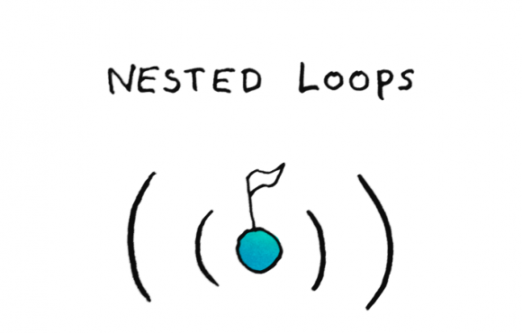
Nested loops(嵌套循环)
A nested loop is a loop within a loop, an inner loop within the body of an outer one.
Nested for
Nested while
Nested do while
How this works is that the first pass of the outer loop triggers the inner loop, which executes to completion. Then the second pass of the outer loop triggers the inner loop again. This repeats until the outer loop finishes.

Slide 33
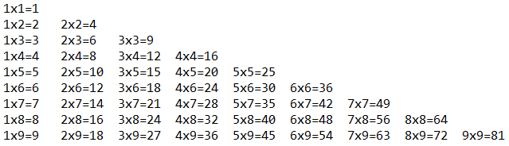
Chinese multiplication table(乘法表)
Also called nine nine table. It was known in China as early as the Spring and Autumn period, and the pupils in Chinese elementary school today still must memorize it.
Let’s print it using java.

Slide 34
Chinese multiplication table
public static void nineNineTable(){
for(int i=1;i<=9;i++){
for(int j=1;j<=i;j++)
System.out.printf(""+j+"x"+i+"="+i*j+"\t");
System.out.println();
}
}

Slide 35

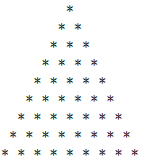


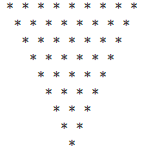

Star Triangles
Print different triangles using ‘*’
lower isosceles triangle
Lower right triangle
Lower left triangle
Upper right triangle
Upper left triangle
upper isosceles triangle
Notes:
isosceles [aɪ'sɒsəli:z]等腰的

Slide 36
Upper left triangle
public static void upperLeftTriangle(int N){
for(int i=0;i<N;i++){
for(int j=1;j<=N-i;j++)
System.out.print("*");
System.out.println();
}
}

Slide 37
Upper right triangle
public static void upperRightTriangle(int N){
for(int i=0;i<N;i++){
for(int j=1;j<=i;j++) //print i white spaces
System.out.print(" ");
for(int j=1;j<=N-i;j++) //print N-i stars
System.out.print("*");
System.out.println();
}
}

Slide 38
Refactor: Upper right or left triangle
public static void upperTriangle(int N, boolean right){
for(int i=0;i<N;i++){
if (right ==true)
for(int j=1;j<=i;j++) //print i white spaces
System.out.print(" ");
for(int j=1;j<=N-i;j++) //print N-i stars
System.out.print("*");
System.out.println();
}
}

Slide 39


